Slide 1
CRM BANK ANALYSIS
BY – SANDESH S MORE

Slide 2
Table of contents
01
INTRODUCTION
02
PROBLEM STATEMENT
05
DASHBOARD
06
CONCLUSION
03
DATA DESCRIPTION
04
OBJECTIVE & SUBJECTIVE INSIGHTS

Slide 3
INTRODUCTION
Developing an Analytical CRM for a bank involves creating sophisticated tools to enhance decision-making through customer data analysis. This specialized system enables banks to gain deeper insights into their customers, identify trends, and make data-driven decisions. By leveraging analytics, banks can segment customers, observe behaviors, predict future actions, and monitor changes effectively.
The goal is to increase customer satisfaction and retention by tailoring offers and campaigns based on data insights. Analytical CRM is crucial for understanding customer behavior, optimizing bank operations, and fostering strong, enduring customer relationships.

Slide 4
PROBLEM STATEMENT Customer churn, or the rate at which customers discontinue using our bank's services, significantly impacts our revenue and profitability. In this presentation, we will examine our bank's customer churn rates, focusing on factors such as gender, recent trends, credit card ownership, the number of products used, credit scores, and the regions from which customers are departing. Our objective is to identify the reasons behind customer attrition and propose strategies to enhance customer satisfaction and retention.

Slide 5
DATA DESCRIPTION

Slide 6
DATA DESCRIPTION
Each customer is distinguished by a unique CustomerId, serving as a primary identifier within the bank's system.
CreditScore provides a numerical assessment of a customer's creditworthiness, categorized into “Poor credit”,”Good credit”,”Very good credit”,”Excellent credit”, and “Super credit”.
GeographyID is a numerical code(1,2,3) indicating the geographical location associated with each customer, typically representing countries or regions.
GenderID is a numeric identifier denoting the gender of the customer, with ‘1’ as commonly representing male and '2' representing female.

Slide 7
DATA DESCRIPTION
Age indicates the age of each customer, a demographic factor influencing various aspects of banking behavior and decisions.
Tenure represents the duration in years for which a customer has been associated with the bank, reflecting their loyalty and relationship maturity.
Balance denotes the current financial balance in each customer's account, which can influence their decision to stay or leave the bank.
NumOfProducts refers to the number of banking products that a customer has subscribed to, indicating their level of engagement and dependency on the bank's services.

Slide 8
DATA DESCRIPTION
HasCrCard specifies whether a customer holds a credit card with the bank, influencing their propensity to churn.
IsActiveMember indicates whether a customer is actively engaged with the bank's services ('1' for active, '0' for inactive), affecting their likelihood of leaving.
Estimated Salary represents an estimation of each customer's annual salary, another factor influencing their retention likelihood based on financial stability.
Exited is a binary indicator ('0' for retained, '1' for exited) revealing whether the customer has left the bank, essential for understanding churn rates and retention strategies.
Bank DOJ (Date of Joining) signifies the date when each customer originally joined or associated with the bank, offering insights into customer tenure and behavior over time.

Slide 9
OBJECTIVE AND SUBJECTIVE INSIGHTS

Slide 10
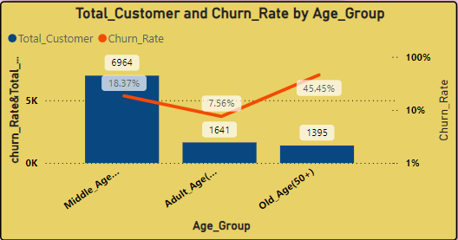
INSIGHT :
The churn rate is highest among customers in the Middle_Age group at 45.45%, followed by the Old Age group (50+) at 10%, and lowest among Adult_Age (35-49) customers at 7.56%. However, without knowing the total number of customers in each age group, it's challenging to determine which group has the highest churn rate in absolute numbers.
RECOMMENDATION:
Investigate Churn Reasons: Focus on understanding why Middle_Age customers are leaving by conducting surveys or focus groups to identify and address their specific pain points.
Improve Retention: Implement targeted loyalty programs, offer discounts, and enhance customer service to retain Middle_Age customers and reduce their churn rate.

Slide 11
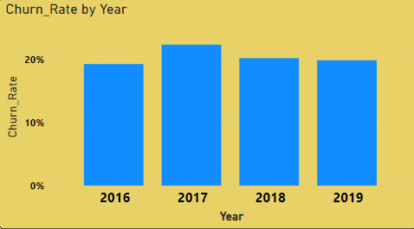
INSIGHT :
From 2016 to 2019, the average churn rate was 20%, which is not ideal since a lower churn rate is preferable. A high churn rate can suggest that customers are dissatisfied with the services or do not find them valuable.
RECOMMENDATION:
Improve Customer Service: Enhance the quality and responsiveness of customer support to increase satisfaction.
Launch Loyalty Programs: Offer rewards and incentives to encourage long-term customer retention.
Gather Customer Feedback: Regularly conduct surveys to understand customer needs and address issues promptly.

Slide 12
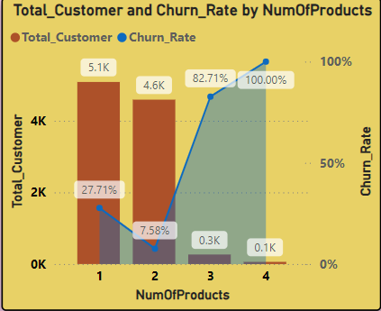
INSIGHT :
Customers who purchase no products have the highest churn rate at 100%, which steadily decreases as the number of products purchased increases. This indicates that customers who see value in the bank's products are more likely to remain loyal. Additionally, the majority of customers have purchased only one product, with the number of customers decreasing as they buy more products..
RECOMMENDATION:
Target New Customers: Focus on acquiring customers who haven't purchased any products by offering discounts or promotions to encourage their first purchase.
Upsell and Cross-Sell: Leverage the lower churn rates among customers with multiple products by recommending complementary products or services to those who have already made a purchase.

Slide 13
ANALYSIS AND KEY INSIGHTS
Germany poses the highest financial risk to the bank due to the highest churn rate (814) and the fewest active members (1248).
France boasts the largest number of active members (2591).
Spain has the lowest number of customers who have churned (413).
There is no significant correlation between the number of active members and the average estimated salary.
Females have a higher churn rate (0.25) compared to males (0.16).

Slide 14
ANALYSIS AND KEY INSIGHTS
The poorest credit score segment (300-579) experiences the highest exit rate.
Possessing a credit card does not significantly affect churn rates.
The most common number of products among customers who have exited the bank is one.
A large number of customers join the bank during the months of august to december.
Individuals aged 30-50 hold the most credit cards.
The highest churn rate and the lowest number of active members indicate that germany is a significant financial risk for the bank

Slide 15
Factors Contributing to Bank Churn:
Customer Satisfaction: Low customer satisfaction often leads to churn. Common reasons include poor customer service, long wait times, and unresolved issues.
Fees and Charges: High fees and charges can drive customers away. If a bank's fees are higher than its competitors or customers perceive them as unfair, they might switch banks.
Competition: Strong competition in the banking industry can result in churn. Customers may switch banks if a competitor offers better rates, attractive incentives, or a more user-friendly experience.

Slide 16
Strategies to Reduce Bank Churn:
Tailored Offers: Use data to personalize discounts and promotions, such as offering cashback on new credit cards to frequent travelers, to match customer preferences.
Loyalty Programs: Introduce reward programs that provide points or discounts for continued usage, which can be redeemed for various benefits like cash back or travel rewards.
Enhanced Customer Service: Improve customer support by training staff to be more helpful and making it easier to contact support. Address issues quickly and use feedback to continuously improve services.

Slide 17
DASHBOARD

Slide 18
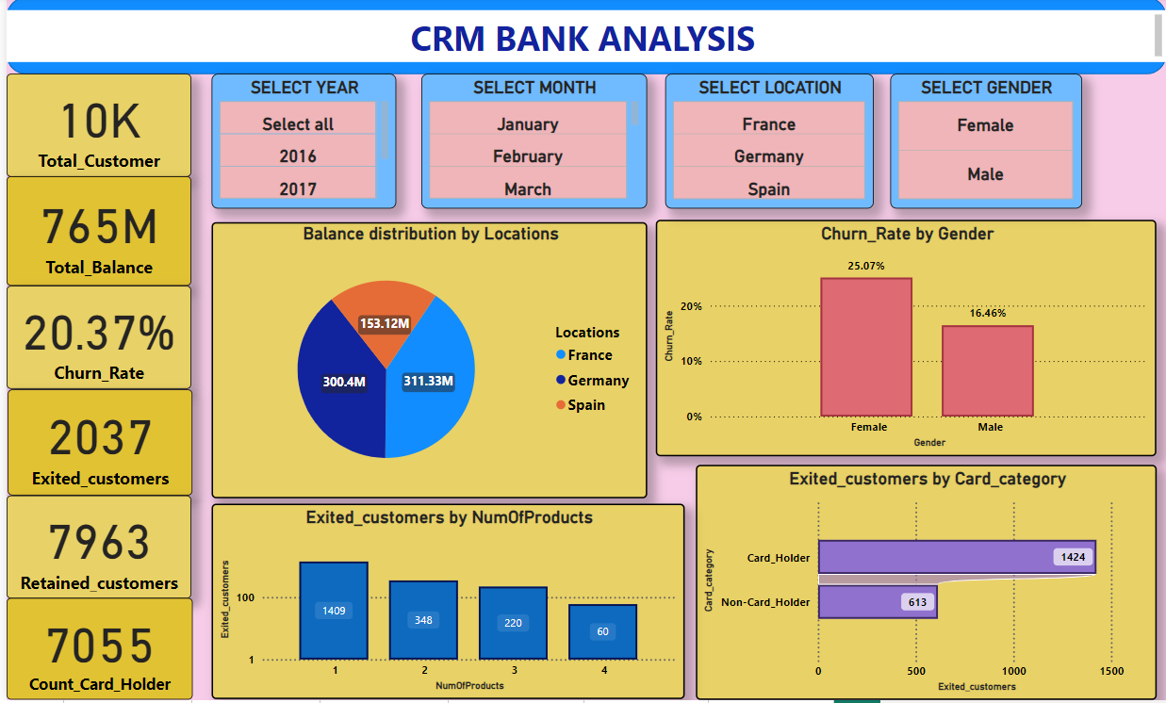

Slide 19
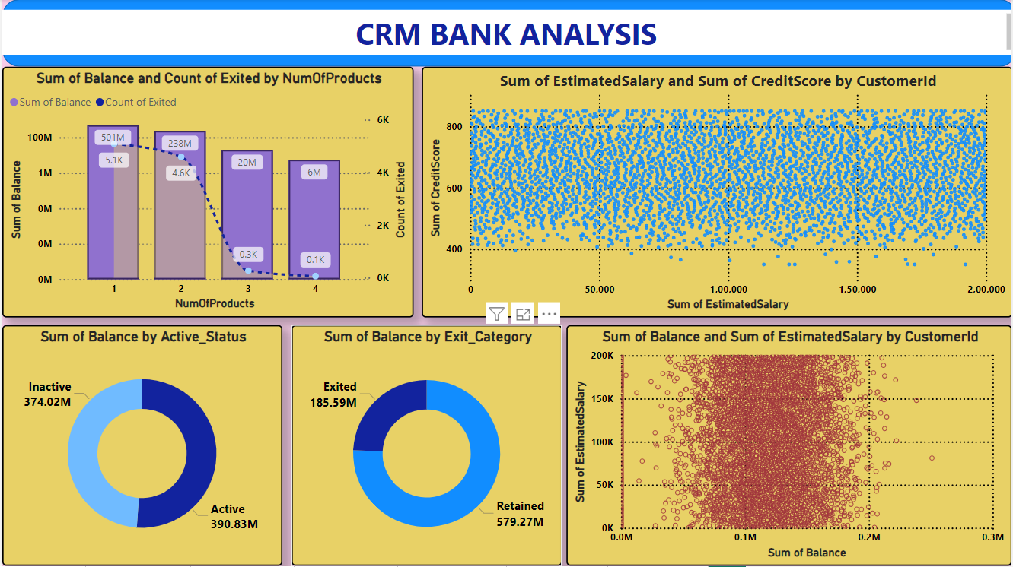

Slide 20
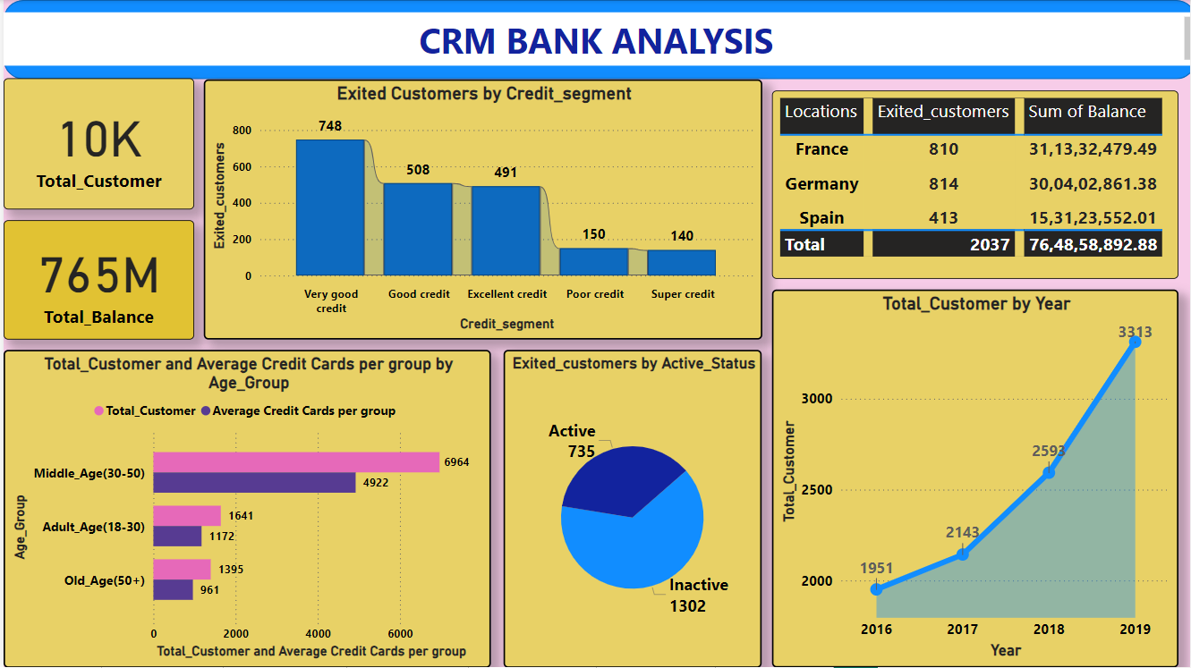

Slide 21
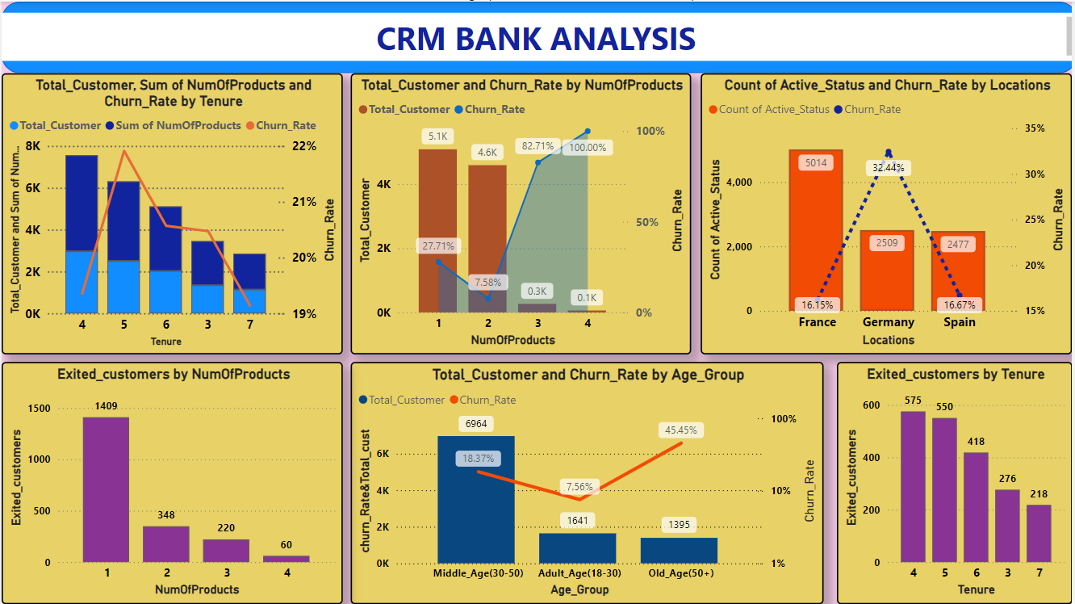

Slide 22
CONCLUSION
The bank has faced a consistent churn rate despite a steady increase in new customers.
Customers with lower credit scores and those using fewer bank products are more likely to churn.
Older and middle-aged groups have the highest churn rates, posing unique retention challenges.
Boosting customer engagement and enhancing customer service are crucial to reducing churn.
Offering competitive products and services can help attract and retain customers.
Targeted marketing and personalized offers can retain key segments based on age and credit score.

Slide 23
THANK YOU…..

